Slide 1
LOAN APPROVAL PREDICTION USING MACHINE LEARNING MODELS
Google Slide Link: https://docs.google.com/presentation/d/1bvOXDqs_5ezLtgVh4gu2DeZsfNF7g01j4ui4nQoCLyA/edit?usp=sharing

Slide 2
The primary objective is to predict if the loan status of the applicant has been approved or not. For this project, we take on the role of financial analyst for a finance company to build our model to predict the outcome of the loan status of customers using different data values.
For this project, we will use the classification model in which we need to classify whether the loan will be approved or not. Classification refers to a predictive modeling problem where a class label is predicted for a given example of input data

Slide 3
Business problem:
We work for a finance company that deals in all kinds of home loans. Usually, an applicant first applies for a home loan and after that, the company validates the customer's eligibility for the loan.
We aim to automate the loan eligibility process (real-time) based on customer details provided while filling out online application forms. These details are:
Gender,
Marital Status,
Education,
number of Dependents,
Income,
Loan Amount,
Credit History,
and others.

Slide 4
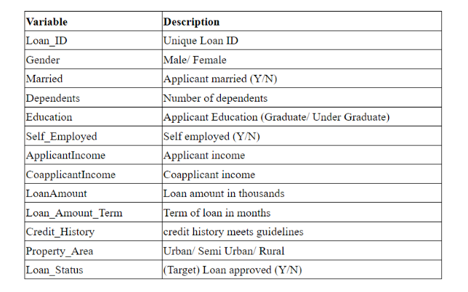
About the dataset:
We have two CSV files which are labeled as train and test data. The train and test dataset would have the same columns except for the target column are “Loan Status”.

Slide 5
Questions the team hopes to answer with the data
The main question/problem that we are trying to solve is if the loan application would be approved or not
We would run a machine learning model to predict this outcome using multiple inputs like :
Loan_ID
Married
Dependents
Education
Self_Employed
ApplicantIncome
CoapplicantIncome
LoanAmount
Loan_Amount_Term
Credit_History
Property_Area
The above inputs are classified as input variables denoted by X and y is the Loan_Status.

Slide 6
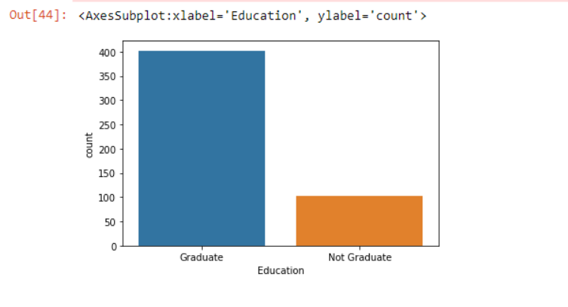
Description of the data exploration phase of the project
The data exploration of the project was conducted an analysis on each variable to tell a story from our data set.
We started by analyzing each input category to understand our data better.
eg: Education column was analyzed to split into a bar graph of graduate and non-graduate

Slide 7
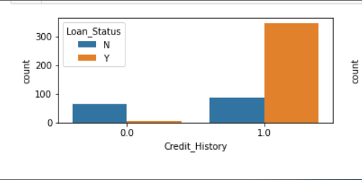
Description of the data exploration phase of the project
Afterwards, we also performed the same analysis based on the target output which is Loan_Status. To do so, we divided our features between numerical data sets and categorical data. This allowed us to see which category in these features had an impact on the loan approval.
eg: Applicants with a credit history had a higher approval rate than those without a credit history

Slide 8
Description of the analysis phase of the project
Since this was a classification problem we used Logistic regression, Decision trees Random Forest classifier and finally Gradient Boost to improvise.
Logistic regression is the base line model used in classification models.
Advantage: it is easier to implement, interpret, and very efficient to train.
Next model was Decision Tree (DT) and the reason to select this model is that it handles Categorical data well.
We also decided to use random forest model as decision trees sometimes are prone to overfitting and single tree may become complex and prone to errors, but many of them can be combined to form a stronger model.
Gradient boosting, is an ensemble method that works sequentially to minimize similar errors and improve accuracy.

Slide 9
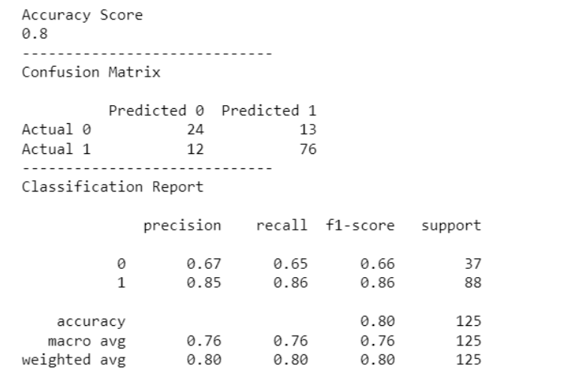
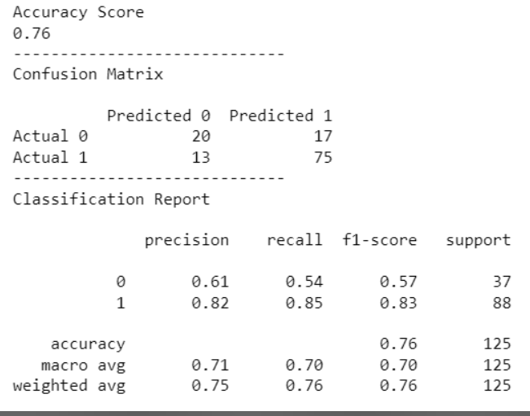
Results from Machine Learning Model
Logistic Regression
Decision Trees

Slide 10
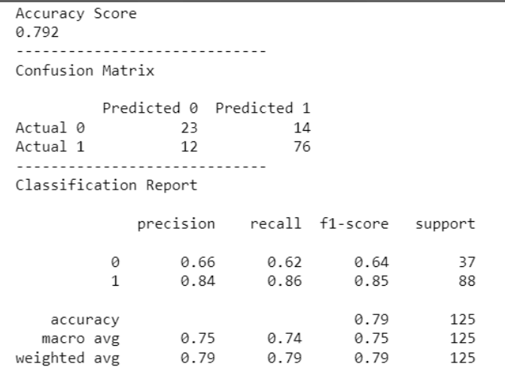
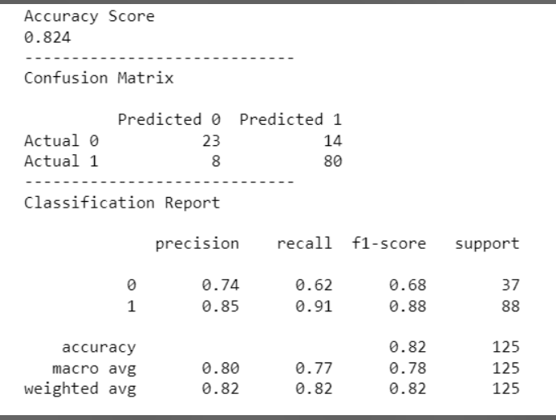
Results from Machine Learning Model
Random Forest
Gradient Boost

Slide 11
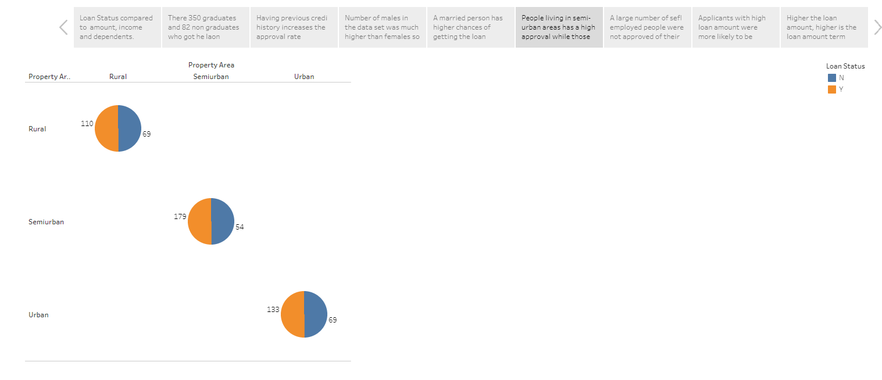
Technologies, languages, tools, and algorithms used throughout the project
We used Pandas and Python to clean the data.
We used AWS for database storage.
Machine Learning using Logistic regression, Decision trees Random Forest classifier and finally Gradient Boost to predict loan application status.
Finally, the dashboard to visualize the findings was performed on Tableau (preview of story page seen below)

